Slide 1
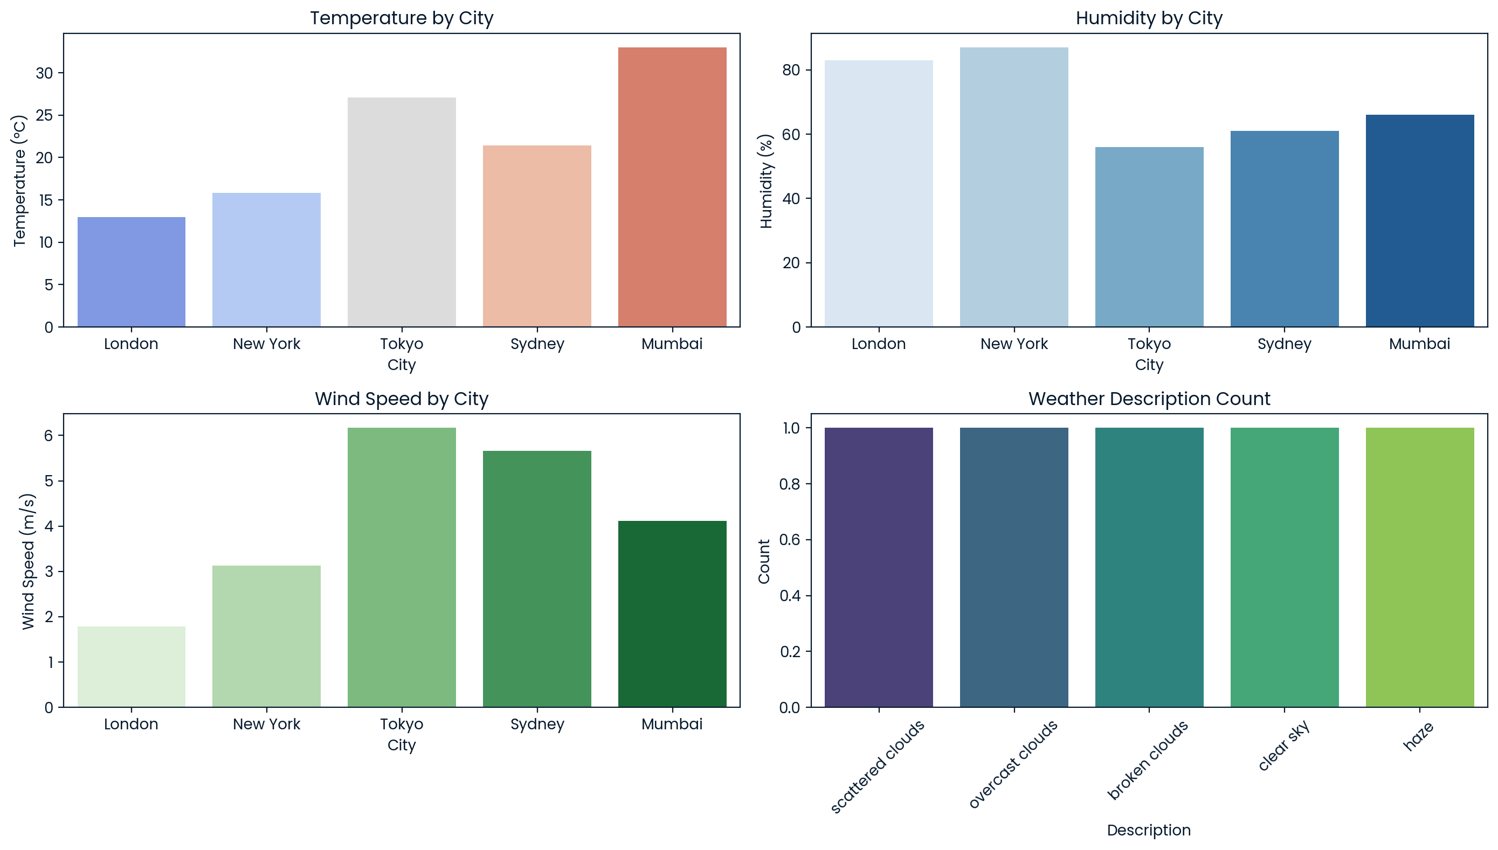
DATA INGESTION PIPELINE
TRANSFORMING WEATHER DATA
A comprehensive ingestion pipeline

Slide 2


Product Overview
GOAL
FOCUS
To build an end-to-end data ingestion pipeline that fetches, processes, and stores weather data for further analysis and reporting
Automating the data collection from OpenWeather API, processing it, and storing it in a PostgreSQL database using Docker and Airflow.
GITHUB: abaya12/weather-data-ingestion-pipeline (github.com)

Slide 3
My role
PROJECT PLANNING
DEVELOPMENT
Defined the project scope, objectives, and timeline
Implemented the data ingestion pipeline, developed Airflow DAGs, and configured Docker containers
DOCUMENTATION
TESTING AND DEBUGGING
Created detailed documentation and a comprehensive README file
Ensured data accuracy, reliability, and handled any technical issues.
GITHUB: abaya12/weather-data-ingestion-pipeline (github.com)

Slide 4

TECHNICAL CHALLENNGES
API LIMIT RATE
Managing API rate limits and ensuring data consistency
Docker configuration
Setting up and configuring Docker containers for Airflow and PostgreSQL
ERROR HANDLING
Implementing robust error handling and logging within the data pipeline.
Data transformation
Implementing robust error handling and logging within the data pipeline.
GITHUB: abaya12/weather-data-ingestion-pipeline (github.com)

Slide 5





SOLUTION APPROACH
Data ingestion
orchestration
containerization
Data storage
Used Python to fetch weather data from OpenWeather API
Employed Apache Airflow to schedule and manage the ETL pipeline.
Utilized Docker to containerize the application, ensuring consistent environments.
Stored processed data in a PostgreSQL database, ensuring it’s readily accessible for analysis.
GITHUB: abaya12/weather-data-ingestion-pipeline (github.com)

Slide 6
RESULT AND IMPACT
AUTOMATED PIPELINE
SCALABILITY
DATA ACCESSIBILITY
EFFICIENCY
Successfully automated the data ingestion and processing pipeline
Built a scalable solution that can handle varying data loads
Provided easy access to processed weather data for analytics and reporting
Reduced manual intervention, allowing for continuous data updates and improved data accuracy
GITHUB: abaya12/weather-data-ingestion-pipeline (github.com)

Slide 7

LESSONS LEARNED
DOCKER AND API INTEGRATION​
ERROR HANDLING AND WORKFLOW MANAGEMENT
Docker Mastery: Gained in-depth understanding of Docker and container orchestration.
API Integration: Learned best practices for integrating and handling third-party APIs.
Error Handling: Developed skills in implementing robust error handling and logging mechanisms.
Workflow Management: Enhanced my ability to design and manage data workflows using Airflow.
GITHUB: abaya12/weather-data-ingestion-pipeline (github.com)

Slide 8

ADAPTABILITY
EVOLVING DATA SOURCE
DYNAMIC CONFIGURATIONS
SCALABLE ARCHITECTURE
Designed the pipeline to accommodate additional data sources with minimal changes
Designed the pipeline to accommodate additional data sources with minimal changes
Built a solution that can scale horizontally to handle increased data volumes and complexity
GITHUB: abaya12/weather-data-ingestion-pipeline (github.com)

Slide 9



TECHNICAL TOOLS
Python
Used for data fetching and processing scripts
AIRFLOW
Managed and scheduled ETL workflows
DOCKER
Containerized the application for consistency and scalability
POSTGRESQL
Stored processed data for analysis and reporting.
OPENWEATHER API
Source of data
GITHUB: abaya12/weather-data-ingestion-pipeline (github.com)

Slide 10

Summary
Expertise: Demonstrated strong abilities in handling complex data engineering challenges.
Innovation: Applied innovative solutions to create a robust and scalable data ingestion pipeline.
Future-Ready: Equipped to handle evolving data sources and project requirements.
GITHUB: abaya12/weather-data-ingestion-pipeline (github.com)

Slide 11


Thank you
SPONSORS
Ishmael Kabu Abayateye
+233 243 0692 37
ishmaelloabtkb19@gmail.com
FACILITATOR
- DEREK DEGBEDZUI

